Slide 1
BITS Pilani

Slide 2
Transport Layer

Slide 3
OBJECTIVES:
To define process-to-process communication at the transport layer and compare it with host-to-host communication at the network layer.
To discuss the addressing mechanism at the transport layer, to discuss port numbers, and to define the range of port numbers used for different purposes.
To explain the packetizing issue at the transport layer: encapsulation and decapsulation of messages.
To discuss multiplexing (many-to-one) and demultiplexing (one-to-many) services provided by the transport layer.
To discuss flow control and how it can be achieved at the transport layer.

Slide 4
OBJECTIVES (continued):
To discuss error control and how it can be achieved at the transport layer.
To discuss congestion control and how it can be achieved at the transport layer.
To discuss the connectionless and connection-oriented services at the transport layer and show their implementation using an FSM.
To discuss the behavior of four generic transport-layer protocols and their applications: simple protocol, Stop-and-Wait protocol, Go-Back-N protocol, and Selective-Repeat protocol.
To describe the idea of bidirectional communication at the transport layer using the piggybacking method.

Slide 5

















Transport services and protocols
provide logical communication between app processes running on different hosts
transport protocols run in end systems
  send side: breaks app messages into segments, passes to network layer
  recv side: reassembles segments into messages, passes to app layer
more than one transport protocol available to apps
  Internet: TCP and UDP
application
transport
network
data link
physical
logical end-end transport
application
transport
network
data link
physical

Slide 6
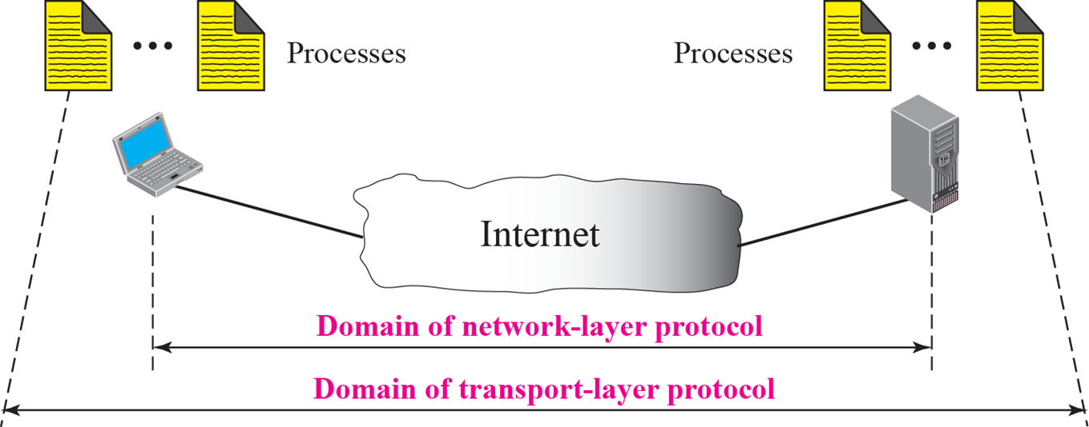
Transport vs. network layer
network layer: logical communication between hosts
transport layer: logical communication between processes
  relies on, enhances, network layer services
household analogy:
12 kids in Ann’s house sending letters to 12 kids in Bill’s house:
hosts = houses
processes = kids
app messages = letters in envelopes
transport protocol = Ann’ multiplexing and Bill’ demultiplexing to in-house siblings
network-layer protocol = postal service

Slide 7





Internet transport-layer protocols
application
transport
network
data link
physical
Reliable, in-order delivery (TCP)
  congestion control
  flow control
  connection setup
Unreliable, unordered delivery: UDP
  no-frills extension of “best-effort” IP
Services not available:
  delay guarantees
  bandwidth guarantees
network
data link
physical
network
data link
physical
logical end-end transport
network
data link
physical
network
data link
physical
network
data link
physical
network
data link
physical
application
transport
network
data link
physical

Slide 8
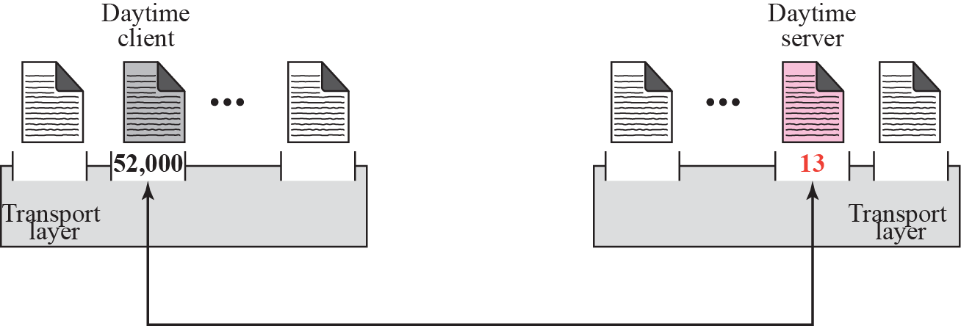
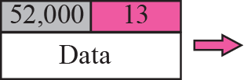
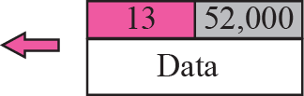
Addressing: Port numbers
To define the hosts, we use IP addresses
To define the processes, we need second identifiers
  Port number
  In the TCP/IP protocol suite, port numbers are integers between 0 and 65,535
Ephemeral (short-lived) port number
  Recommended to be greater than 1,023 and to be used for client.
Well-known port number
  Universal port numbers for servers

Slide 9
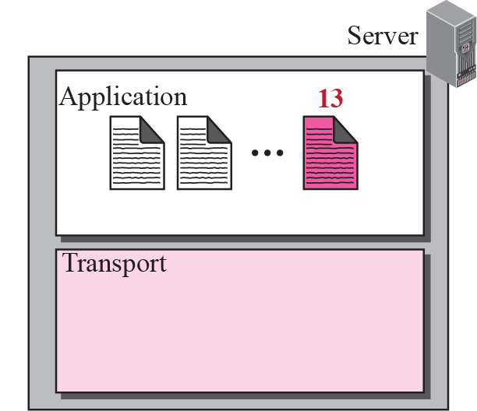
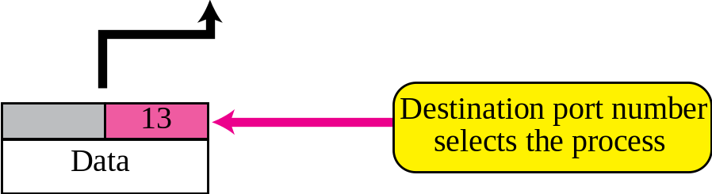
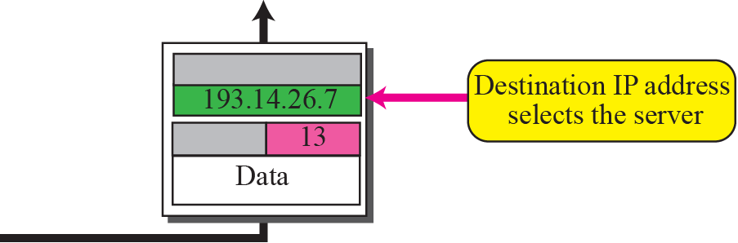
IP addresses versus port numbers

Slide 10
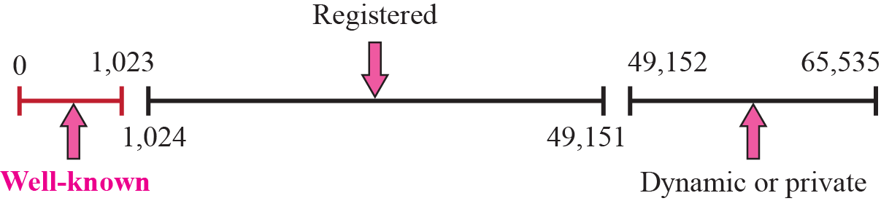
Internet Corporation for Assigned Names and Numbers (ICANN) Ranges
Well-known ports : 0 ~ 1,023
  Assigned and controlled by ICANN
Registered ports : 1,024 ~ 49,151
  Not assigned and controlled by ICANN
  Can be registered with ICANN to prevent duplication
Dynamic ports : 49,152 ~ 65,535
  Can be used as temporary or private port number

Slide 11
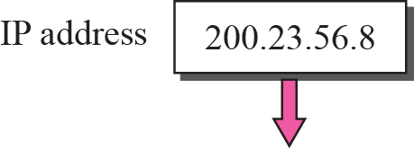
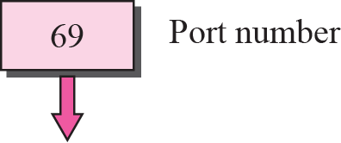

Socket address
The combination of an IP address and a port number

Slide 12
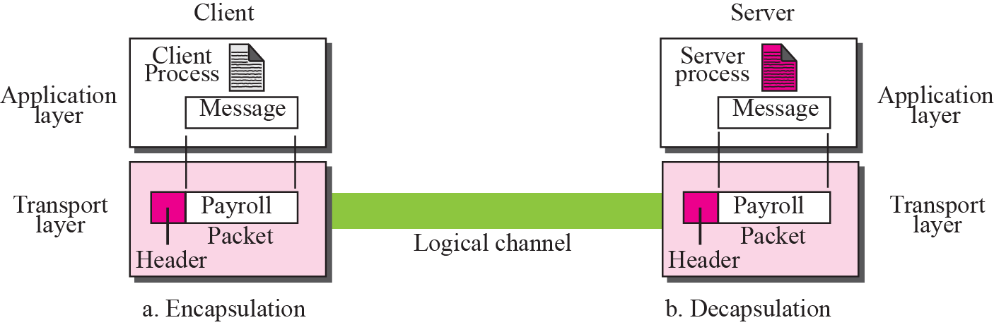
Encapsulation and decapsulation
Encapsulation
  Happen at the sender site
  Add the transport-layer header
Decapsulation
  Happen at the receiver site
  The header is dropped

Slide 13
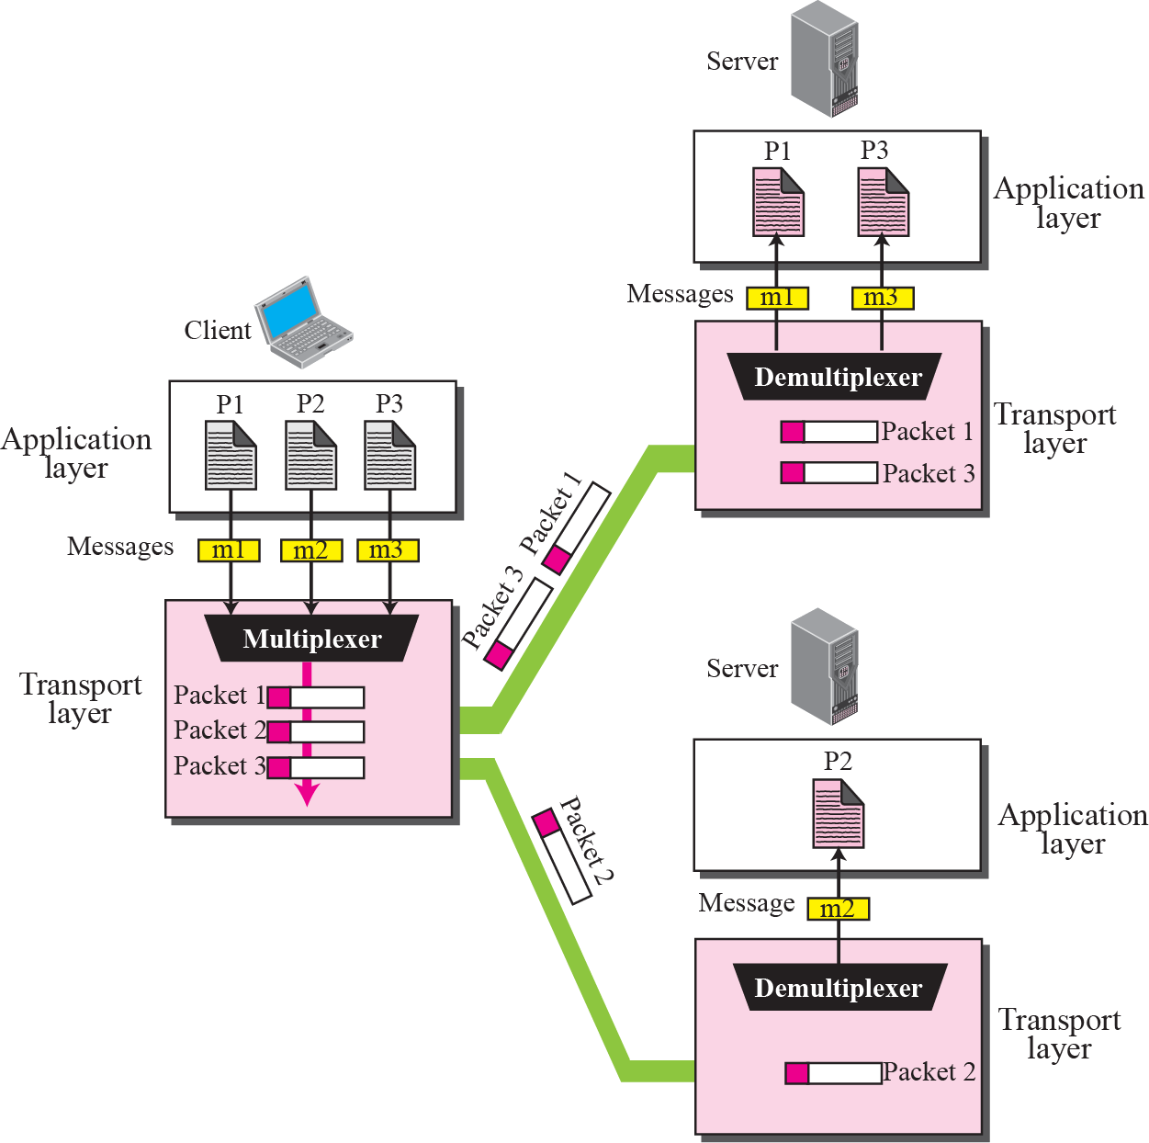
Multiplexing and demultiplexing
Multiplexing
  Entity accepts items from
  more than one source
Demultiplexing
  Entity deliver items to more
  than one source

Slide 14
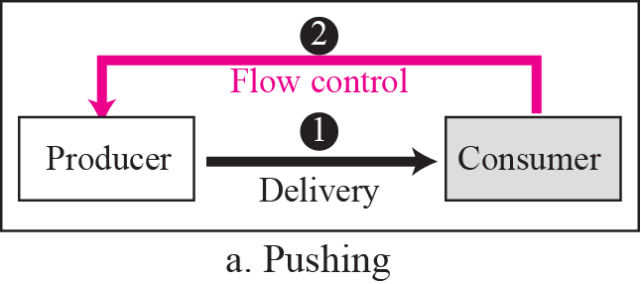
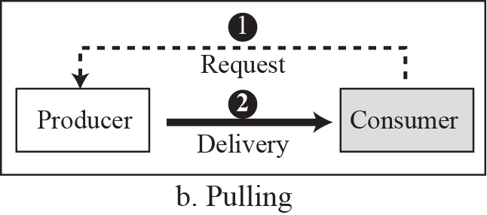
Flow Control
Balance between production and consumption rates
Delivery of items from a producer to a consumer
  Pushing : sender delivers items whenever they produced
  Pulling : producer delivers the items after the consumer has requested

Slide 15
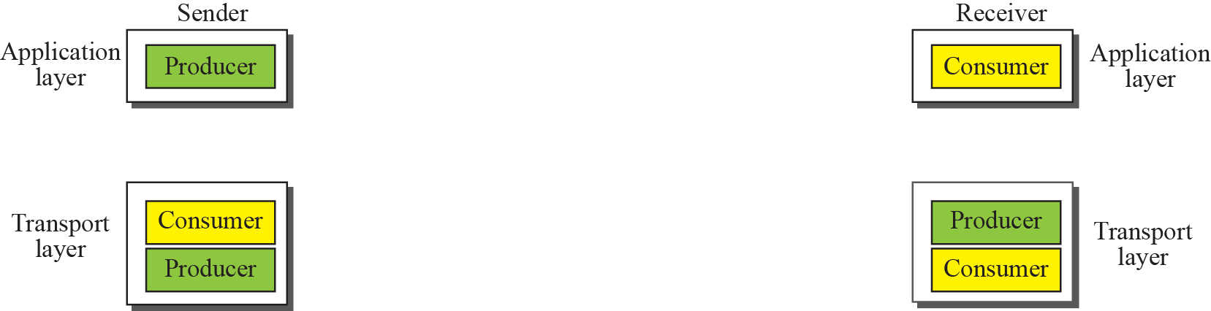
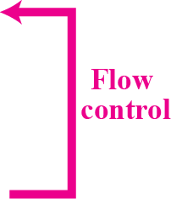
Flow control at the transport layer
One of the solutions to implement flow control is normally to use two buffers.
One at the sending transport layer and the other at the receiving transport layer.
A buffer is a set of memory locations that can hold packets at the sender and receiver.

Slide 16
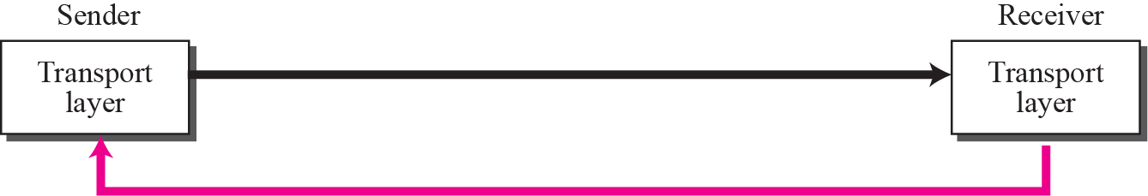
Error control at the transport layer
Error control at the transport layer is responsible to
1. Detect and discard corrupted packets.
2. Keep track of lost and discarded packets and resend them.
3. Recognize duplicate packets and discard them.
4. Buffer out-of-order packets until the missing packets arrive.
Packets
Error Control

Slide 17
Error Control: Sequence Number
The transport layer packet to hold the sequence number of the packets.
Sequence Number help to decide,
  Which packet is to be resent
  Which packet is a duplicate
  Which packet has arrived out of order
Limit on sequence number
  If the header of the frame allows m bits for sequence number, the sequence numbers range from 0 to 2^{m} – 1. for m = 3, sequence numbers are: 0,1, 2, 3, 4, 5, 6, 7.
  We can repeat the sequence numbers.
    0, 1, 2, 3, 4, 5, 6, 7, 0, 1, 2, 3, 4, 5, 6, 7, 0, 1, …
For error control, the sequence numbers are modulo 2m, where m is the size of the sequence number field in bits

Slide 18
Error Control: Acknowledgment
The receiver side can send an acknowledgement for each or a collection of packets that have arrived safe and sound
Both positive and negative acknowledgement.

Slide 19
Combination of Flow Control and Error Control
Flow control requires the use of two buffers, one at the sender site and the other at the receiver site.
The error control requires the use of sequence and acknowledgment numbers by both sides.
These two requirements can be combined if use two numbered buffers, one at the sender, one at the receiver.
Sliding window

Slide 20
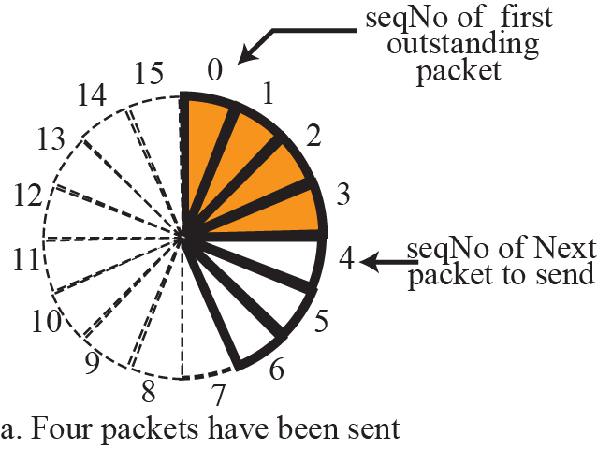
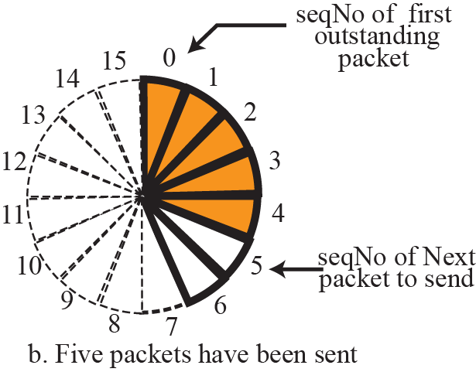
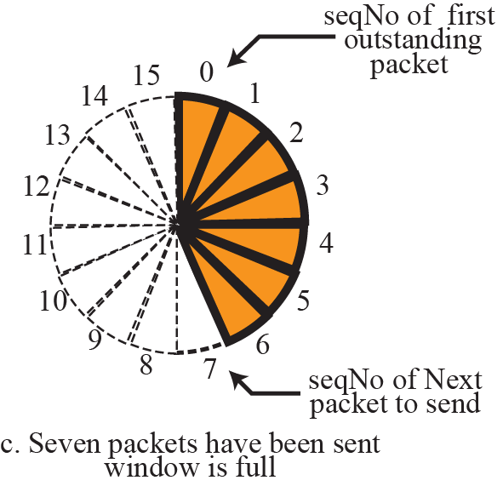
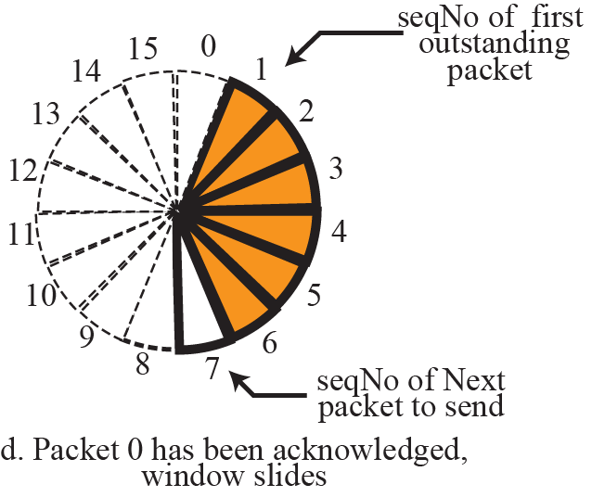
Sliding window in circular format

Slide 21
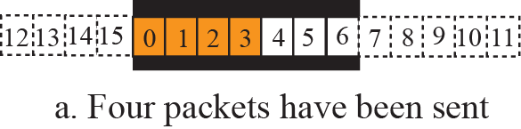
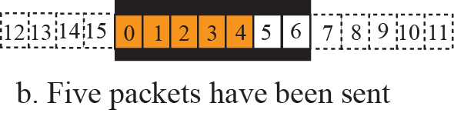
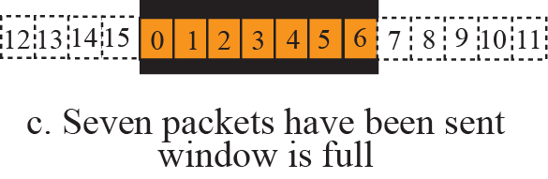
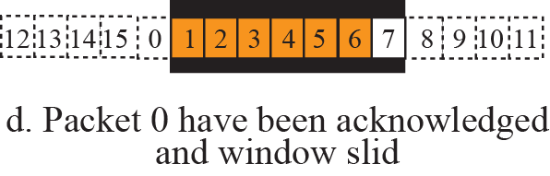
Sliding window in linear format

Slide 22
Congestion Control
Occur if the load on the network is greater than the capacity of the network
Open-loop congestion control :prevent congestion before it happens
  Retransmission policy : using retransmission timer
  Window policy : selective repeat and go-back-N window
  Acknowledgment policy : using timer, a ACK for N packets
Closed-loop congestion control: alleviating congestion after it happens
  Flexible window size

Slide 23
Connectionless and Connection-Oriented Service
Connectionless service
  Divide messages into chunks of data
  No dependency between the packets
  The packets may arrive out of order
Connection-oriented service
  Establish a connection between a server and a client.
  After data exchange, the connection needs to be teared down

Slide 24
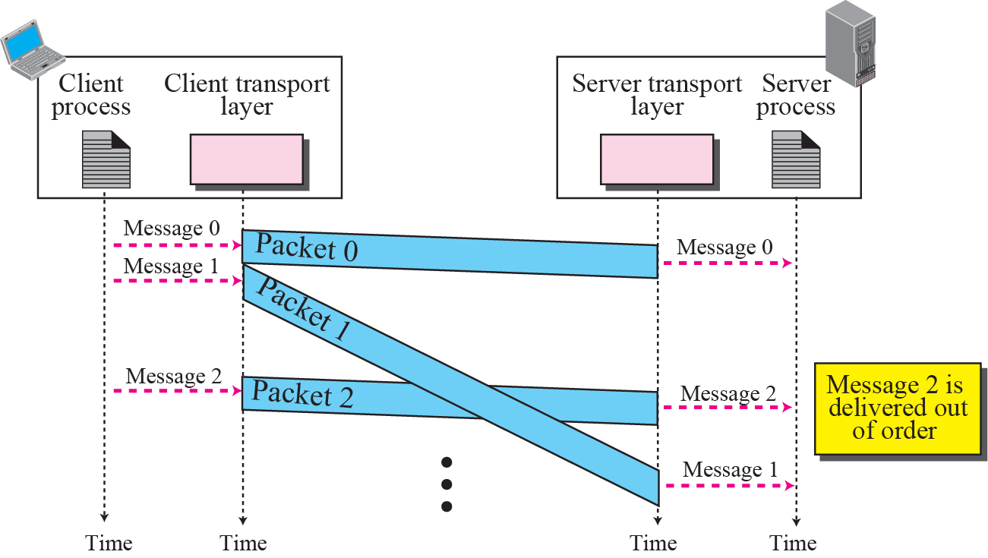
Connectionless service

Slide 25
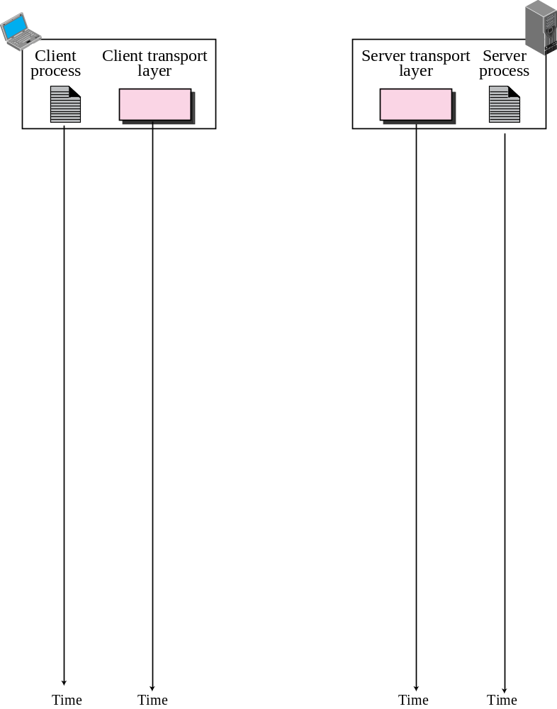
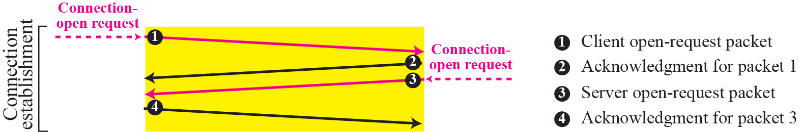
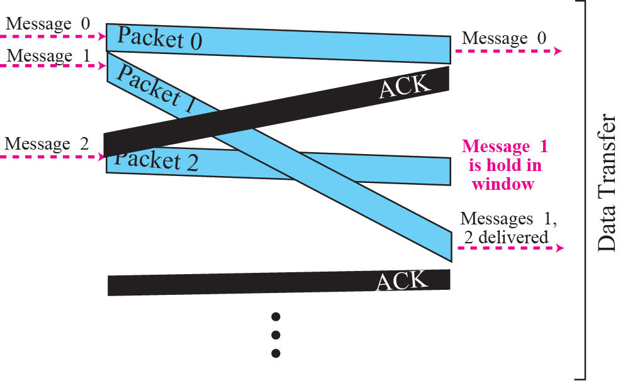
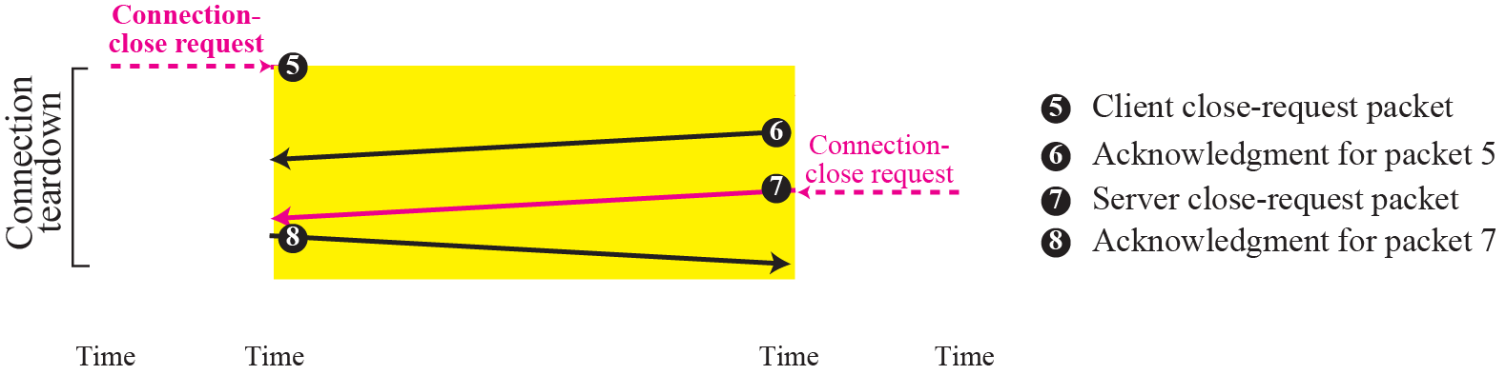
Connection-oriented service

Slide 26
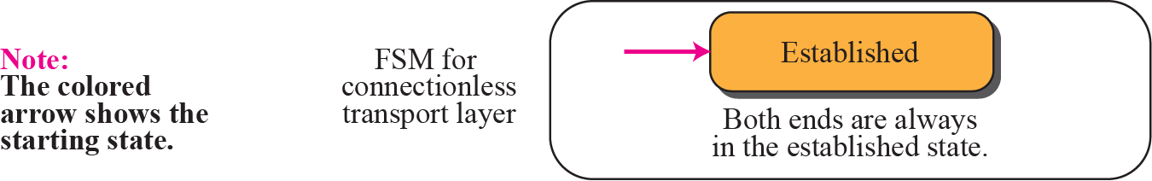
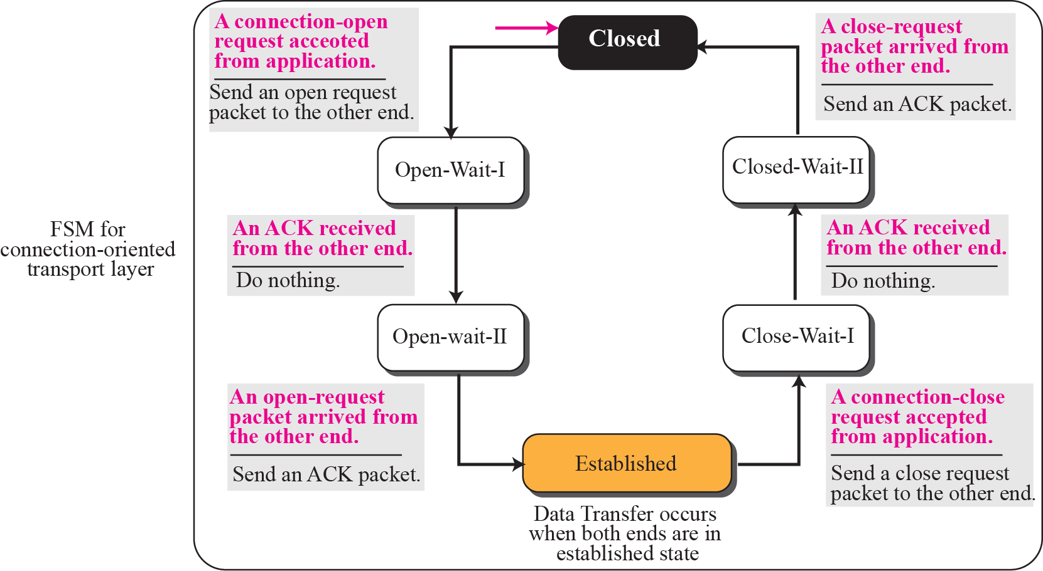
Connectionless and connection-oriented services as FSMs

Slide 27
Transport Layer Protocols
Simple connectionless protocol
  No flow control and error control
Connection-oriented protocol
  Stop-and-Wait protocol
    Provide flow and error control
  Go-Back-N protocol
    Efficient version of Stop-and-Wait protocol
  Selective-Repeat Protocol
    Suited to handle packet loss
  Piggybacking

Slide 28
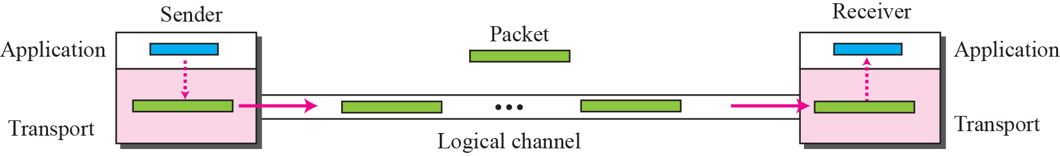
Simple protocol
The simple protocol is a connectionless protocol that provides neither flow nor error control.

Slide 29
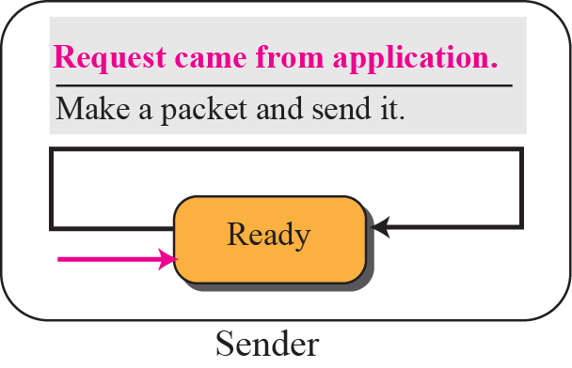
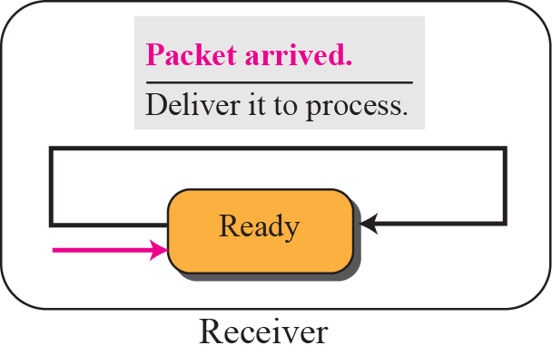
FSMs for simple protocol

Slide 30
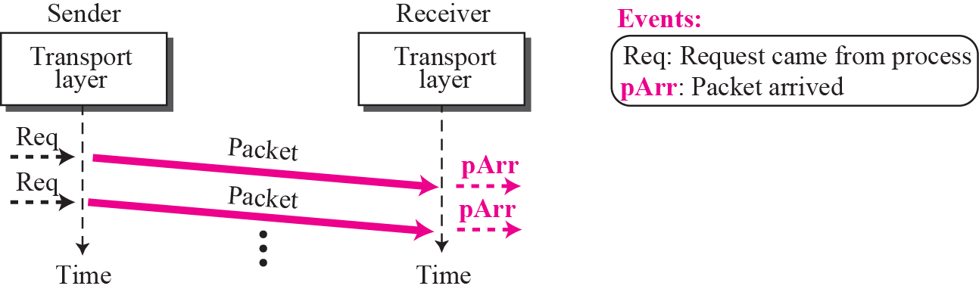
Example
Figure shows an example of communication using this protocol. It is very simple. The sender sends packets one after another without even thinking about the receiver.

Slide 31
Stop-and-Wait Protocol
Use both flow and error control
  Both the sender and the receiver use a sliding window of size 1.
The sender sends one packet and waits for an ACK before sending the next one.
Add a checksum to detect corrupted packets
When sender sends a packet, it starts a timer
  If an ACK arrives, timer is stopped
Either the packet was lost or corrupted, the sender resends the previous packet

Slide 32
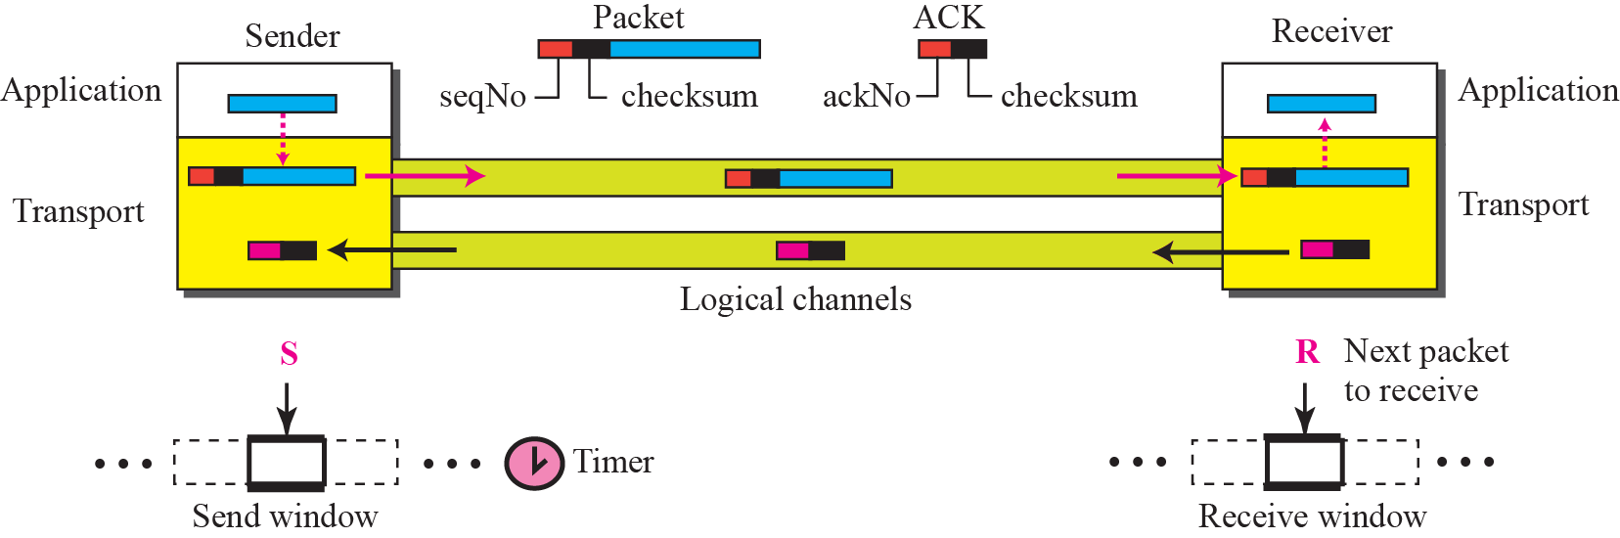
Stop-and-wait protocol

Slide 33

Note
In Stop-and-Wait protocol, flow
control is achieved by forcing the sender to wait for an acknowledgment, and error control is achieved by discarding corrupted packets and letting the sender resend unacknowledged packets when the timer expires.
In the Stop-and-Wait protocol, we can use a 1-bit field to number the packets. The sequence numbers are based on modulo-2 arithmetic.
In the Stop-and-Wait protocol, the acknowledgment number always announces in modulo-2 arithmetic the sequence number of the next packet expected.

Slide 34
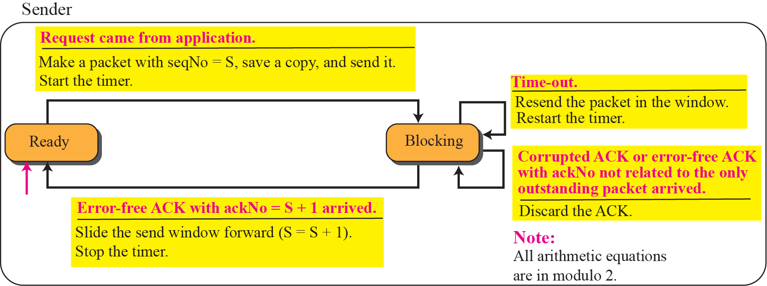
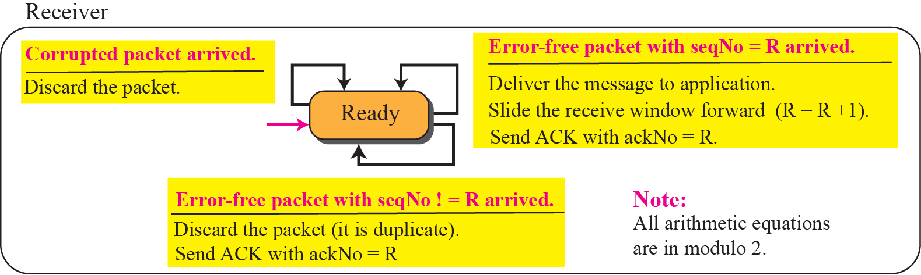
FSMs for stop-and-wait protocol

Slide 35
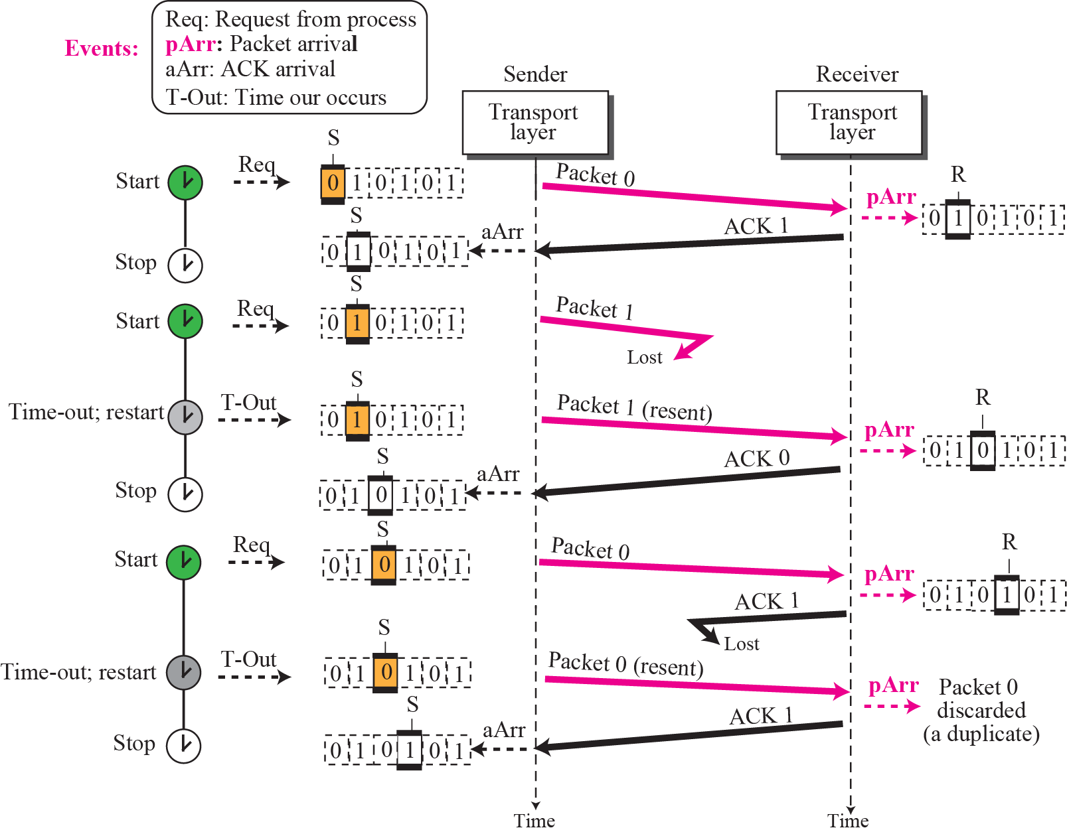
Figure 13.21 shows an example of Stop-and-Wait protocol. Packet 0 is sent and acknowledged. Packet 1 is lost and resent after the time-out. The resent packet 1 is acknowledged and the timer stops. Packet 0 is sent and acknowledged, but the acknowledgment is lost. The sender has no idea if the packet or the acknowledgment is lost, so after the time-out, it resends packet 0, which is acknowledged.

Slide 36
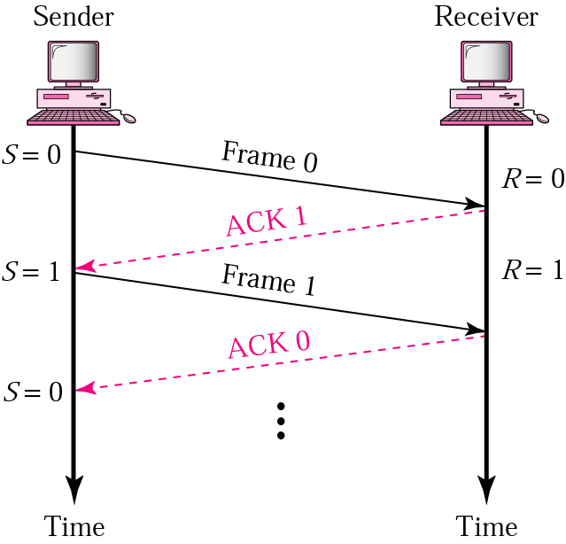
STOP-AND-WAIT
Sender keeps a copy of the last frame until it receives an acknowledgement.
For identification, both data frames and acknowledgements (ACK) frames are numbered alternatively 0 and 1.
Sender has a control variable (S) that holds the number of the recently sent frame. (0 or 1)
Receiver has a control variable (R) that holds the number of the next frame expected (0 or 1).
Sender starts a timer when it sends a frame. If an ACK is not received within a allocated time period, the sender assumes that the frame was lost or damaged and resends it
Receiver send only positive ACK if the frame is intact.
ACK number always defines the number of the next expected frame

Slide 37
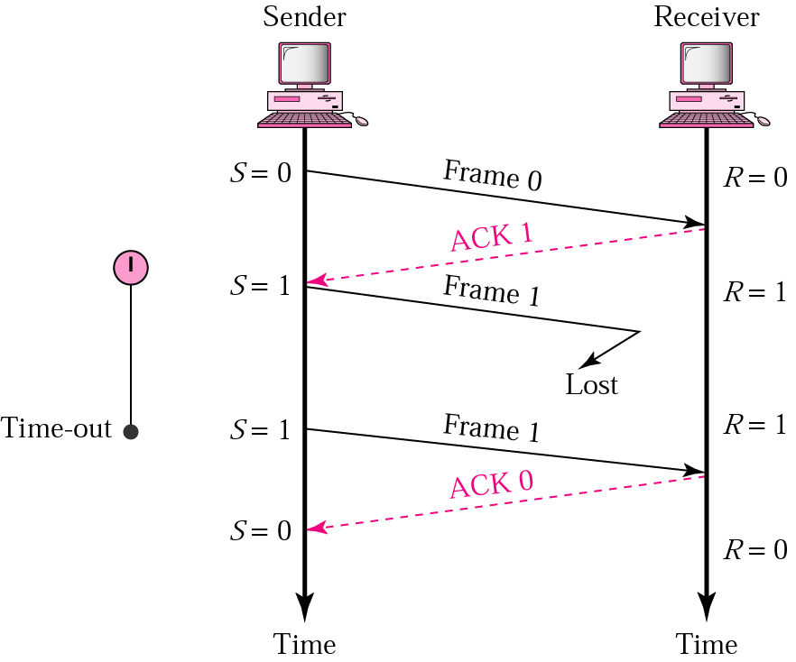
STOP-AND-WAIT ARQ, LOST DATA FRAME
When a receiver receives a damaged frame, it discards it and keeps its value of R.
After the timer at the sender expires, another copy of frame 1 is sent.
To detect corrupted frame CRC is added to each data frame. And check for the error at the receiver

Slide 38
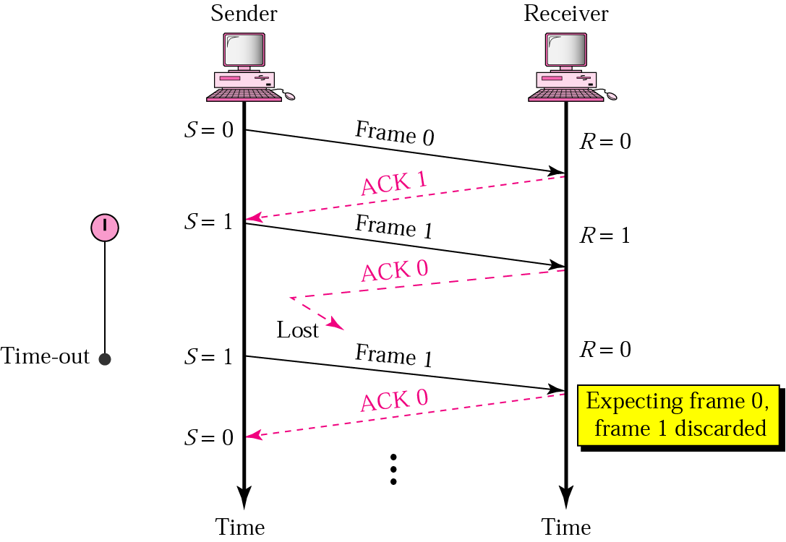
STOP-AND-WAIT, LOST ACK FRAME
If the sender receives a damaged ACK, it discards it.
When the timer of the sender expires, the sender retransmits frame 1.
Receiver has already received frame 1 and expecting to receive frame 0 (R=0). Therefore it discards the second copy of frame 1.

Slide 39
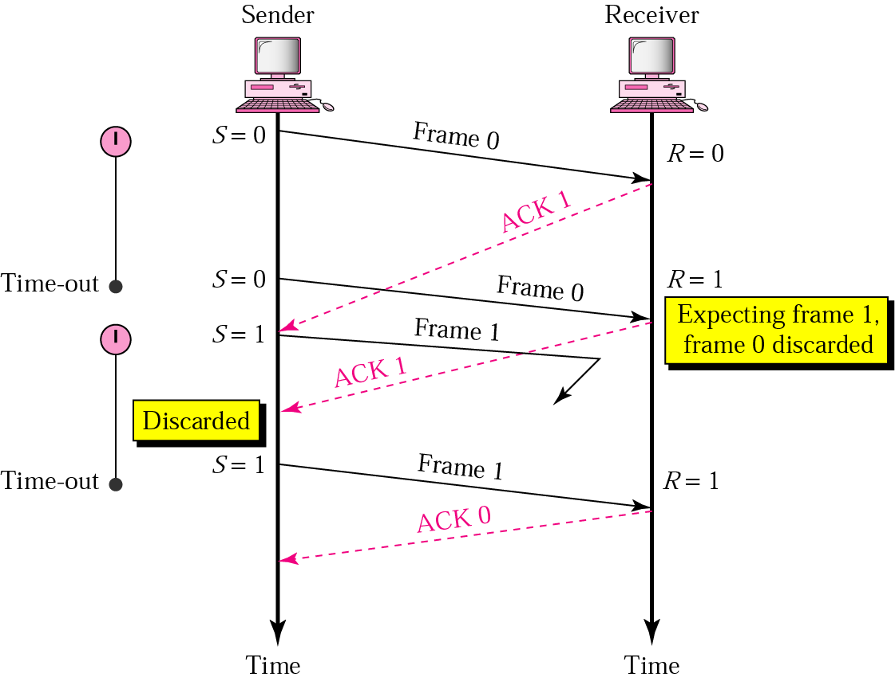
STOP-AND-WAIT, DELAYED ACK FRAME
The ACK can be delayed at the receiver or due to some problem
It is received after the timer for frame 0 has expired.
Sender retransmitted a copy of frame 0. However, R =1 means receiver expects to see frame 1. Receiver discards the duplicate frame 0.
Sender receives 2 ACKs, it discards the second ACK.

Slide 40
DISADVANTAGE OF STOP-AND-WAIT
In stop-and-wait, at any point in time, there is only one frame that is sent and waiting to be acknowledged.
This is not a good use of transmission medium.
To improve efficiency, multiple frames should be in transition while waiting for ACK.

Slide 41
Sliding Window Protocal
Multiple frames sent by source are acknowledged by receiver using a single ACK frame.
Sliding window refers to an imaginary boxes that hold the frames on both sender and receiver side.
It provides the upper limit on the number of frames that can be transmitted before requiring an acknowledgment.
Frames may be acknowledged by receiver at any point even when window is not full on receiver side.
Two protocol use the above concept,
  Go-Back-N ARQ
  Selective Repeat ARQ

Slide 42
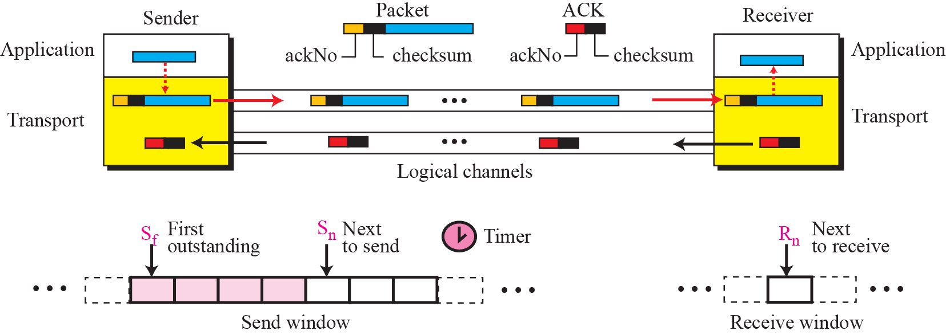
Go-Back-N protocol

Slide 43
Go-Back-N ARQ
We can send up to N frames before worrying about ACKs.
We keep a copy of these frames until the ACKs arrive.
This procedure requires additional features to be added to Stop-and-Wait ARQ.

Slide 44
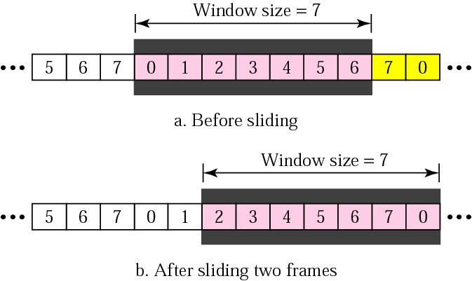
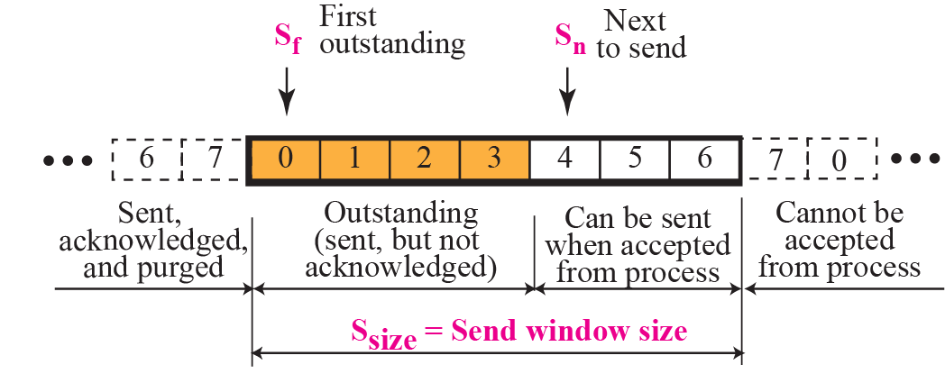
Sender Sliding Window
At the sending site, to hold the outstanding frames until they are acknowledged, we use the concept of a window.
The size of the window is at most 2^{m} -1 where m is the number of bits for the sequence number.
Size of the window can be variable, e.g. TCP.
The window slides to include new unsent frames when the correct ACKs are received

Slide 45
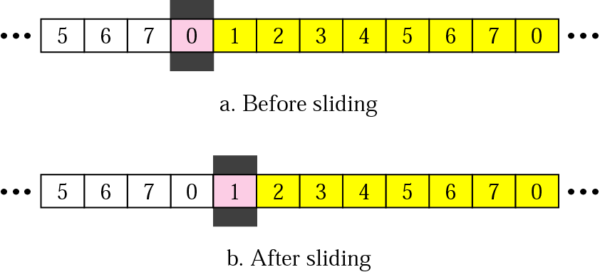
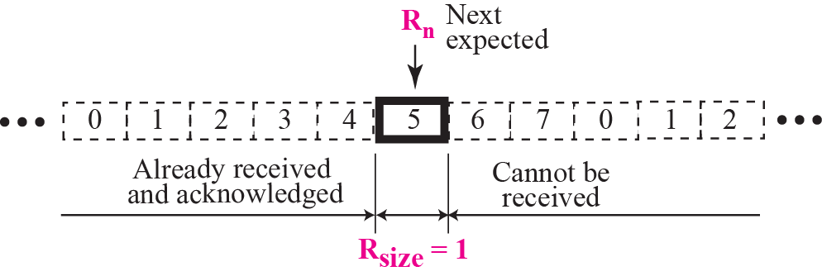
Receiver Sliding Window
Size of the window at the receiving site is always 1 in this protocol.
Receiver is always looking for a specific frame to arrive in a specific order.
Any frame arriving out of order is discarded and needs to be resent.
Receiver window slides as shown in fig. Receiver is waiting for frame 0 in part a.

Slide 46
Acknowledgement
Receiver sends positive ACK if a frame arrived safe and in order.
If the frames are damaged/out of order, receiver is silent and discard all subsequent frames until it receives the one it is expecting.
The silence of the receiver causes the timer of the unacknowledged frame to expire.
Then the sender resends all frames, beginning with the one with the expired timer.
For example, suppose the sender has sent frame 6, but the timer for frame 3 expires (i.e. frame 3 has not been acknowledged), then the sender goes back and sends frames 3, 4, 5, 6 again. Thus it is called Go-Back-N-ARQ
The receiver does not have to acknowledge each frame received, it can send one cumulative ACK for several frames.

Slide 47
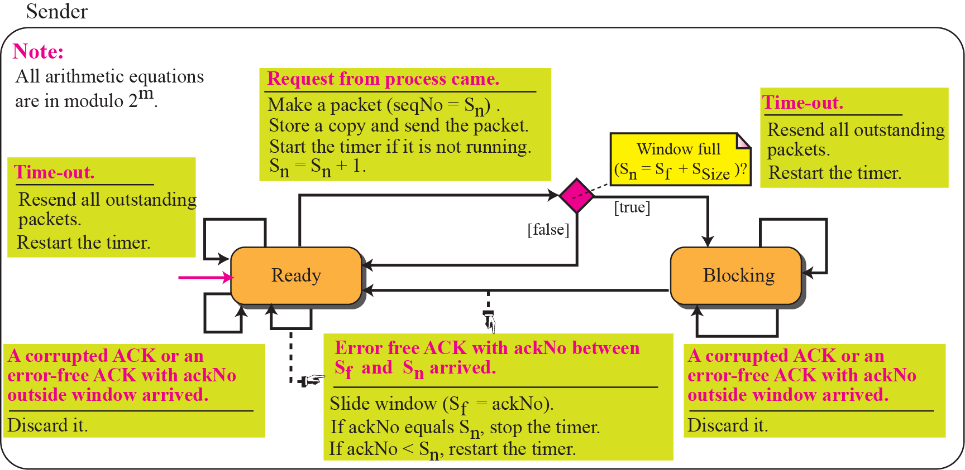

FSMs for Go-Back-N

Slide 48

Go-Back-N ARQ, normal operation
The sender keeps track of the outstanding frames and updates the variables and windows as the ACKs arrive.

Slide 49

Go-Back-N ARQ, lost frame
Frame 2 is lost
When the receiver receives frame 3, it discards frame 3 as it is expecting frame 2 (according to window).
After the timer for frame 2 expires at the sender site, the sender sends frame 2 and 3. (go back to 2)

Slide 50
Go-Back-N ARQ, damaged/lost/delayed ACK
If an ACK is damaged/lost, we can have two situations:
If the next ACK arrives before the expiration of any timer, there is no need for retransmission of frames because ACKs are cumulative in this protocol.
If ACK1, ACK2, and ACk3 are lost, ACK4 covers them if it arrives before the timer expires.
If ACK4 arrives after time-out, the last frame and all the frames after that are resent.
Receiver never resends an ACK.
A delayed ACK also triggers the resending of frames

Slide 51


Go-Back-N ARQ, sender window size
Size of the sender window must be less than 2 ^{m}. Size of the receiver is always 1. If m = 2, window size = 2 ^{m} – 1 = 3.
Fig compares a window size of 3 and 4.

Slide 52

Figure 13.28 shows an example of Go-Back-N. This is an example of a case where the forward channel is reliable, but the reverse is not. No data packets are lost, but some ACKs are delayed and one is lost. The example also shows how cumulative acknowledgments can help if acknowledgments are delayed or lost.

Slide 53

Outline of Selective-Repeat

Slide 54

Send window for Selective-Repeat protocol

Slide 55

Receive window for Selective-Repeat protocol
In the Selective-Repeat protocol, an acknowledgment number defines
the sequence number of the error-free packet received.

Slide 56
Assume a sender sends 6 packets: packets 0, 1, 2, 3, 4, and 5. The sender receives an ACK with ackNo = 3. What is the interpretation if the system is using GBN or SR?
Solution
If the system is using GBN, it means that packets 0, 1, and 2 have been received uncorrupted and the receiver is expecting packet 3. If the system is using SR, it means that packet 3 has been received uncorrupted; the ACK does not say anything about other packets.

Slide 57


FSMs for SR protocol

Slide 58
At the sender, packet 0 is transmitted and acknowledged. Packet 1 is lost. Packets 2 and 3 arrive out of order and are acknowledged. When the timer times out, packet 1 (the only unacknowledged packet) is resent and is acknowledged. The send window then slides.

Slide 59

Example

Slide 60


Selective-Repeat window size

Slide 61

PIGGYBACKING
A method to combine a data frame with ACK.
Station A and B both have data to send.
Instead of sending separately, station A sends a data frame that includes an ACK.
Station B does the same thing.
Piggybacking saves bandwidth.

Slide 62

Design of piggybacking for Go-Back-N

Slide 63
In GB3, if every 5th packet that is being transmitted is lost and if we have to send 10 packet , then how many transmissions are required.
In SR with window size 3, if every 5th packet that is being transmitted is lost and if we have to send 10 packet , then how many transmissions are required.
In GB4, if every 6th packet that is being transmitted is lost and if we have to send 10 packet , then how many transmissions are required.

Slide 64
TCP Encapsulation

Slide 65

Format of TCP Segment

Slide 66
TCP Header Fields
Source port (16 bits)
  Identifies the process at the local end.
Destination port (16 bits)
  Identifies the process at the remote end.
Sequence number (32 bits)
  Used for reliable delivery of message.
  Each byte of message is assigned a 32-bit number that is incremented sequentially.
  The field holds the number of the first byte in that TCP segment.

Slide 67
TCP Header Fields
Acknowledgement Number (32 bits)
  Used by remote host to acknowledge receipt of data.
  Contains the number of the next byte expected to be received.
HLEN (4 bits)
  Specifies the header length in number of 32-bit words. Header can be between 20 and 60 bytes.

Slide 68
TCP Header Fields
Flags (6 bits)
  There are six flags.
    URG is set to 1 if the urgent pointer is in use.
    A connection request is sent by making SYN=1 and ACK=0.
    A connection is confirmed by sending SYN=1 and ACK=1.
    When the sender has no more data, FIN=1 is sent to release the connection.
    RST bit is used to reset a connection. It is also used to reject a connection attempt.
    PSH bit indicates the push function. Used to indicate end of message.

Slide 69
TCP Header Fields
Window (16 bits)
  Specifies how many bytes may be sent beyond the byte acknowledged.
  This number, called window advertisement, can increase or decrease as needed.
  A value of zero closes the window altogether.
Checksum (16 bits)
  Applies to the entire segment and a pseudo-header.
  The pseudo-header contains the following IP header fields:
    Source IP address, destination IP address, protocol, segment length.
    TCP protects itself from misdelivery by IP
    (delivered to wrong host).
  Same algorithm as used in IP.

Slide 70

TCP Connection Establishment

Slide 71

TCP Connection Establishment & Termination

Slide 72

Connection establishment using three way handshaking

Slide 73


Data Transfer

Slide 74

Connection Termination

Slide 75

Half Close

Slide 76

Format of UDP Segment

Slide 77
UDP Header Fields
Source port (16 bits)
  Identifies the process at the local end.
Destination port (16 bits)
  Identifies the process at the remote end.
Message length (16 bits)
  Specifies the size of the datagram in bytes (UDP header plus data).
Checksum (16 bits)
  Computed in the same way as TCP.
  This is optional; set to zero if not used.

